Slide 1


Slide 2
Purpose
The CARBON DIOXIDE SAFETY MANUAL has been published by the RFA to help facilities understand CO₂ health effects and control CO₂ exposures

Slide 3
Module 4:
Overview of CO₂ Monitoring Instruments and Ventilation Techniques
Notes:
The fourth module is this one, Overview of CO₂ Monitoring Instruments and Ventilation Techniques.

Slide 4
Today’s Presentation
How to determine plant-specific CO₂ alarm levels
Placement of stationary alarms
How NDIR electronic sensors work
Example single and multi-gas monitors and uses
Direct-reading detector and dosimeter tubes
Ventilation considerations and techniques
Notes:
Slide 4: Today’s Presentation
Today we are going to cover in detail these specific points:
How to determine plant-specific CO₂ alarm levels
Placement of stationary alarms
How NDIR electronic sensors work
Example single and multi-gas monitors and their uses
Direct-reading detector and dosimeter tubes and how to use
Ventilation considerations and specific techniques

Slide 5
Deciding Plant-Specific CO₂ Alarm Levels
Determine the lowest acceptable level of CO₂ exposure that your facility can operate under
Trial and error may work to establish this point
May be different in different parts of the facility
Under no circumstances should your level be higher than 5,000 ppm
Notes:
In order to prevent unsafe levels of CO₂, we first must identify what unsafe levels are. OSHA’s CO₂ exposure standards are out of date and do not protect workers adequately. Each facility needs to operate at the lowest level of CO₂ emissions that can be achieved.
To do this:
Determine the lowest acceptable level of CO₂ that your facility can operate under to effectively protect workers’ thinking and cognitive abilities, remembering that cognitive functions – thinking skills – are impaired at 1000 ppm. Trial and error may work to establish this point, which may be different in different parts of the facility.
Keep in mind that the eight-hour, time-weighted average workplace exposure level established by OSHA in 1970 was 5,000 ppm, so under no circumstances should your level be higher than this.

Slide 6
Prevent Unsafe CO₂ Levels
Carefully consider the placement of CO₂ sensors
Common for sensors to be located along walkways and open areas that have good ventilation – but this does not give a true indication of trouble spots and corners
Notes:
Once exposure levels are established and alarm set points determined, give careful consideration to the placement of these sensors.
Having many remote sensors still may not provide adequate protection. That is because it is all too common for remote monitors to be placed in the middle of buildings or along main walkways, to get broad representative readings of the general work area.
However, this often backfires and results in sensors being located along walkways and open areas that have good ventilation. This gives everyone a false sense of security.

Slide 7
Prevent Unsafe CO₂ Levels (cont.)
Sensors should be located at dead areas and remote corners of buildings where little ventilation is present; worst case locations
Dead spaces give a better indication of actual CO₂ accumulations that can jeopardize worker safety
Notes:
The sensors should be located, or relocated, to dead areas and remote corners of buildings and areas where little ventilation is present. Look for the worst case locations, knowing that CO₂ levels will not be worse than there.
Sampling of “dead spaces” will give a much better indication of actual CO₂ accumulation that can jeopardize worker safety.
Consider locating one CO₂ monitor at the supplied air point of entry to the work area, to know if CO₂ is being blown into the work area.

Slide 8
Ensure mechanical ventilation of work areas and parts of buildings and vessels where CO₂ can collect
Activate ventilation remotely, before workers enter those areas; or
activate automatically when a CO₂ remote monitor reads levels that exceed your site’s critical set point
Notes:
Ventilation needs to be remotely activated when workers enter areas where it is possible for CO₂ to collect.
Ensure mechanical ventilation is remotely activated in work areas, especially those areas in corners or the sides of buildings and vessels, where carbon dioxide can collect. The ventilation does not need to run continuously; however, it needs to be able to be activated either
manually: before workers enter those areas, or
automatically: when a carbon dioxide remote monitor reads levels that exceed your facility’s critical set point.
It is common practice for these monitors to be tied into the control room, so operators know when carbon dioxide levels exceed established limits.
The facility needs to be monitored with a number of monitors to give broad representative readings. It is only in this way that accurate assessments of CO₂ exposure levels can be made over time.
Resist the pitfalls of assuming general area CO₂ levels adequately represent all exposures.
Install remote sensors to determine carbon dioxide levels in various parts of the facility.
Ethanol manufacturing facilities need remotely located CO₂ continuously monitoring sensors. These should have local audible and visual alarms.
Install interlocks from the electronic monitors so that ventilation equipment will automatically start up when critical set points are exceeded, which should not be more than 5,000 ppm CO_{2.}
In addition, consider tying the signals into control rooms to notify operators.

Slide 9
Local and Remote Audible and Visual Alarms
Stationary monitors need to have local and remote audible and visual alarms
Must activate automatically when levels are detected that exceed your site’s critical set point

Slide 10
Establishing a Preventive Maintenance Program
Institute a preventive maintenance program to ensure proper operation of these CO₂ continuously monitoring sensors
Ensure that the recommendations of the manufacturer are followed
Notes:
Institute a preventive maintenance program to ensure proper operation of these CO₂ continuously monitoring sensors
Ensure that the recommendations of the manufacturer are followed

Slide 11
CO₂ Monitoring Equipment
Electronic and chemical monitors that give results instantaneously, within minutes, or by the end of the workshift
Notes:
In this part of our program today we are going to cover the highlights of each type of equipment and show examples. Additional information is given in Chapter 11 of the Carbon Dioxide Safety Program entitled, “Carbon Dioxide Sampling Equipment.” This chapter covers the various types of CO₂ sampling equipment, including specific details on how each works, and the advantages and disadvantages of each type.
Many different types of equipment are available today to detect the presence of carbon dioxide, from levels that exceed background up to levels that exceed life-threatening concentrations. The broad types of equipment we will review all measure carbon dioxide without needing to have samples sent to a laboratory and waiting for their analyses to get the results – which can often exceed a week or more.
Note that OSHA (the Occupational Safety and Health Administration) and NIOSH (the National Institute of Occupational Safety and Health) also have sampling methods that have been reviewed and these include the equipment types described below as well as methods that need to be analyzed by a laboratory. Consult the Appendices in the Carbon Dioxide Safety Program for equipment examples as well as OSHA sampling methods. Specifically, see Appendix D: Additional OSHA CO₂ Sampling Methods, for these government-approved methods.
The examples of equipment described in this section and the Carbon Dioxide Safety Program are for demonstration purposes only. Their use in this document is not to be construed as an endorsement of any of these specific products by the RFA.

Slide 12
Portable and Stationary Electronic Carbon Dioxide Gas Monitors
Notes:
The equipment we will discuss, including stationary, multi-gas, and single sensor monitors, all give CO₂ concentrations immediately.
Electronic monitors are the fastest, the most reliable and the most accurate of all CO₂ monitoring equipment. These include:
Single-gas, stationary CO₂ monitors that can give an audible alarm, flashing lights and also be tied into a computer remotely to inform personnel when an area of the facility exceeds a pre-set threshold level of CO₂,
Portable multi-gas monitors that are excellent for confined space entry, plant surveys, and other uses, and
Portable, single-gas monitors that can be worn or hand held.
Remember that the best electronic sensors use NDIR technology – which give the most accurate readings, are rugged, and maintain calibration well.

Slide 13
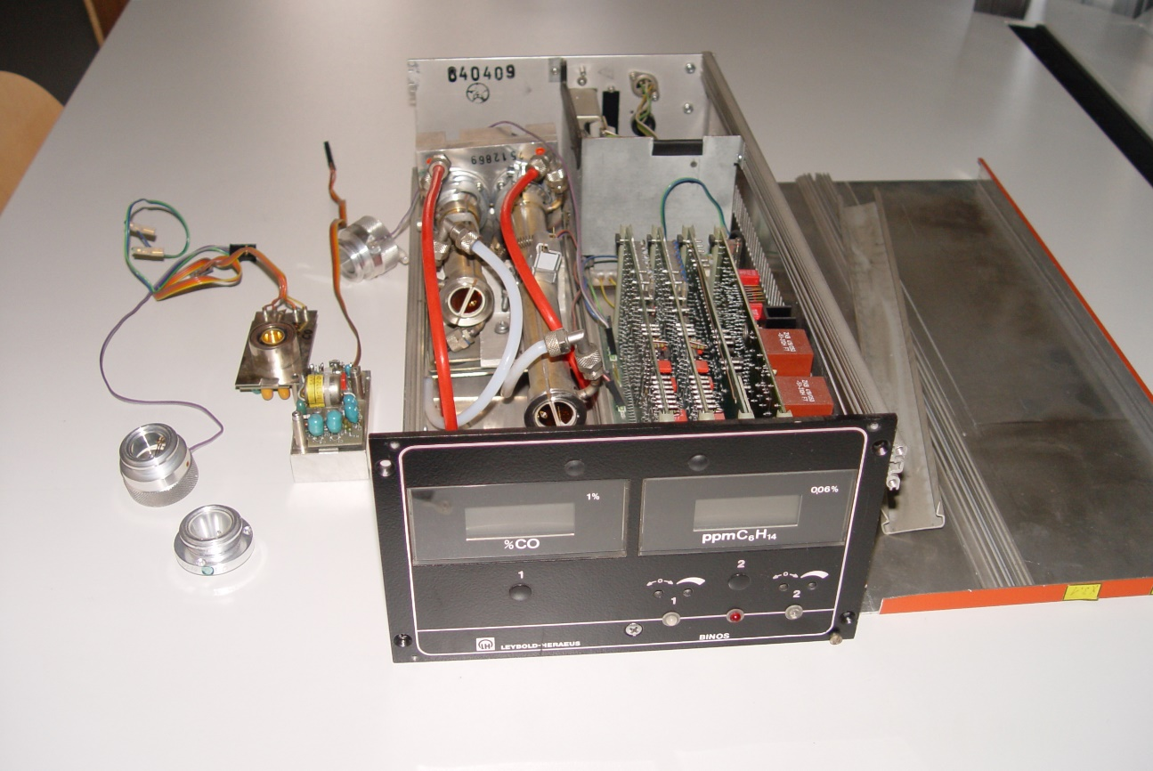
NDIR Sensor Operation
Notes:
NDIR stands for “non-dispersive infrared” sensors. Using electronic monitors is critical to effectively assessing worker exposure.
This picture shows a stationary CO₂ monitor. It can send readings back to a control room computer, and when the set point is exceeded, it can activate alarms, flashing lights, and start up a fan to ventilate the area.
Slide 14: NDIR Sensor Main Components
NDIR sensors have 3 main components:
An Infrared source (lamp),
A sample chamber or light tube, and a
Light filter with an infrared detector

Slide 14
NDIR Sensor Main Components
Infrared source (lamp)
Sample chamber or light tube
Light filter with an infrared detector
Notes:
Slide 14: NDIR Sensor Main Components
NDIR sensors have 3 main components:
An Infrared source (lamp),
A sample chamber or light tube, and a
Light filter with an infrared detector

Slide 15
NDIR Sensor Operation
IR light is directed through the sample chamber towards the detector
In parallel another chamber with an enclosed reference gas
The gas in the sample chamber causes absorption of specific wavelengths according to Beer–Lambert law
Notes:
The NDIR sensors measure CO₂ as a function of the absorbance of infrared light at a specified wavelength
IR (infrared) light is directed through the sample chamber towards the detector
It functions in parallel with another chamber with an enclosed reference gas
The gas in the sample chamber causes absorption of specific wavelengths according to the Beer–Lambert law

Slide 16
NDIR Sensor Operation (cont.)
The attenuation of these wavelengths is measured by the detector to determine the gas concentration
The detector has an optical filter in front that eliminates all light except the wavelength CO₂ gas molecules can absorb
The more CO₂, the higher the reading
Notes:
The attenuation of these wavelengths is measured by the detector to determine the CO₂ gas concentration
The detector has an optical filter in front that eliminates all light except the wavelength CO₂ gas molecules can absorb
The more CO₂ present, the higher the reading
OPTIONAL: Theory of Operation NDIR Sensors
According to Robert Henderson, MBA, President of GFG Instrumentation, Inc., Ann Arbor, MI., a recognized technical expert in direct-reading monitoring equipment, this is the theory of how these sensors work:
The most widely used technique for real-time measurement of carbon dioxide is by means of non-dispersive infrared (NDIR) sensors that measure CO₂ as a function of the absorbance of infrared light at a specified wavelength.
Molecules can be conceptualized as balls (atoms) held together by flexible springs (bonds) that can vibrate (stretch, bend, or rotate) in three dimensions. Each molecule has certain fixed modes in which this vibratory motion can occur. Vibrational modes are dictated by the nature of the specific bonds that hold the molecule together. The larger the molecule, the greater the number of modes of movement.
Each mode represents vibrational motion at a specific frequency. The modes are always the same for a specific molecule. Chemical bonds absorb infrared radiation. The bond continues to vibrate at the same frequency but with greater amplitude after the transfer of energy. For infrared energy to be absorbed (that is, for vibrational energy to be transferred to the molecule), the frequency must match the frequency of the mode of vibration.
Specific molecules absorb infrared radiation at precise wavelengths. When infrared radiation passes through a sensing chamber containing a specific contaminant, only those wavelengths that match one of the vibration modes are absorbed. The rest of the light is transmitted through the chamber without hindrance. The presence of a particular chemical group within a molecule thus gives rise to characteristic absorption bands. Because most chemical compounds absorb at a number of different frequencies, IR absorbance can provide a “fingerprint” for use in identification of unknown contaminants.
Alternatively, for some molecules it may be possible to find an absorbance peak at a specific wavelength that is not shared by other molecules likely to be present. In this case, absorbance at a particular wavelength can be used to provide substance-specific measurement for a specific molecule. Carbon dioxide has such an absorbance peak at a wavelength of 4.26 microns (µm).
Absorbance of infrared light at this wavelength is proportional to the concentration of CO₂ present in the sensor’s sensing chamber. The absorbance is not linear per concentration unit but is mathematically predictable and easily calculated by microprocessor-equipped portable gas detectors.
How the Electronic CO₂ Sensor Works
Miniaturized NDIR CO₂ sensors include an infrared light source (typically a tungsten filament lamp) capable of emitting light in the desired wavelengths. Optical filters are used to limit the light transmitted through the sensing chamber to a narrow range of wavelengths. Most NDIR CO₂ sensors are dual detector systems that provide both a reference and an active signal.
Pyroelectric detectors capable of measuring absorbance at the specific wavelengths of interest are used to provide the measurement and reference signals. The active detector in a CO₂ sensor measures the amount of light in the 4.26 microns (µm) range that reaches the detector after passing through the sensing chamber. The reference detector measures the amount of light at another wavelength (or range of wavelengths) where there is no absorbance for the gas of interest. The greater the concentration of CO₂, the greater the reduction in the amount of light that reaches the active detector when compared to the reference signal.
NDIR equipment is now very commonly used in portable gas monitors and CO₂ is a readily available gas for detectors. Many wineries, breweries, fuel ethanol manufacturers, coal mines, fracking operations, grain handlers, shipyards, municipalities, sewage treatment facilities, concrete producers, contractors, and a wide variety of other industries that have the potential for carbon dioxide exposures use these instruments because they are rugged, easy to calibrate, and a relatively inexpensive way to keep workers safe.
http://oshonline.com/Articles/2006/07/Carbon-Dioxide-measures_up-as-a-Real-Hazard.aspx)

Slide 17
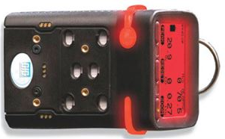
Multi-Gas Detector
Notes:
This is a photo of a portable, multi-gas detector.

Slide 18
Multi-Gas Detector Essentials
Continuously measures and displays readings for 5-6 gases at the same time
Incorporates a built-in concussion-proof boot to survive tough environments
A single on-off button for normal day-to-day operations
CO₂ sensor uses rugged, accurate NDIR technology
Notes:
The GfG G460 Multi-Gas Detector shown in the picture can have sensors for up to 6 gases with simultaneous readings for all of them, for the same cost as a 4-gas monitor.
It incorporates a built-in, concussion-proof boot to survive tough environments
It uses a single on-off button for normal day-to-day operations
The CO₂ sensor uses rugged, accurate NDIR technology
I has an optional built-in flashlight
It is highly water resistant (IP 67), bright, flashing 360° LED alarms and a loud – 103 dB (decibel) buzzer
The downloadable event and datalogging come standard

Slide 19
Multi-Gas Detector Essentials (cont.)
Motorized pump permits operation by either simple diffusion or with pump drawing air
Automatically makes adjustments and retains the three most recent calibration dates for each sensor
Automatic calibration adjustment
Notes:
This G460 monitor comes with an optional motorized pump that permits operation by either simple diffusion or with a motorized pump drawing air
It automatically makes adjustments and retains the three most recent calibration dates for each sensor
It uses automatic calibration adjustment

Slide 20
Multi-Gas Detector Essentials (cont.)
Interchangeable smart-sensors are available for O₂, H₂S, CO, NH3, SO₂, CI₂, PH₃, NO₂, HCN, ETO, ClO₂, HF, O₃, NO and H₂
Infrared (NDIR) sensors are used for direct measurement of CO₂, and
Photoionization detectors (PID) are used for the measurement of volatile organic chemicals (VOCs)
Notes:
Look for a compact monitor like this one with interchangeable smart-sensors. Many models are available to use O₂ (oxygen), H₂S (hydrogen sulfide), CO (carbon monoxide), NH₃ (ammonia), SO₂ (sulfur dioxide), CI₂ (chlorine), PH₃ (phosphine), NO₂ (nitrogen dioxide), HCN (hydrogen cyanide), ETO (ethylene oxide), ClO₂ (chlorine dioxide), HF (hydrogen fluoride), O₃ (ozone), NO (nitric oxide), and H₂ (hydrogen).
Infrared (NDIR) sensors are used for direct measurement of CO₂, and
Photoionization detectors (PID) for the measurement of volatile organic chemicals (VOCs)

Slide 21
Advantages of NDIR Sensor
Very accurate
Easy to calibrate
Maintains calibration well
Rugged
Instant readings
Easy to use
Can be programmed to give an average exposure level over time
Notes:
Very accurate
Easy to calibrate
Maintain calibration well
Rugged
Instant readings
Easy to use
Can be programmed to give an average exposure level over time

Slide 22
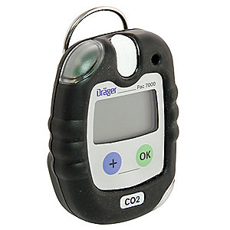
Single CO₂ Gas Detectors
Notes:
This is a photo of another brand of NDIR CO₂ monitors. However, this one monitors for CO₂ only. It has a clip so that it can be worn by the worker on the outside of the shirt or jacket, or it can be hand-held.
Since these only have one sensor, they are smaller than a multi-gas monitor.

Slide 23
Single CO₂ Gas Detectors
Simple two-button operation,
Uses integral rubber over mould for durability,
Has a large display with bright backlight, loud audible alarm, and visual & vibrating alarms.
These features are on the multi-gas monitor as well.
Notes:
These monitors have similar features to the multi-gas monitors.
These monitors work with a simple two-button operation,
They incorporate an integral rubber over moulding for durability,
They have a large display with bright backlight, a loud audible alarm, and visual & vibrating alarms.

Slide 24
Single CO₂ Gas Detectors (cont.)
1-handed operation, even when wearing gloves
Automatic bump tests
Adjustable TWA and STEL alarms
IP65 dust and water ingress protection
Notes:
1-handed operation, even when wearing gloves
Automatic bump tests
Look for adjustable TWA (time-weighted average) and STEL (short-term exposure limit) alarms
Dust and water ingress protection

Slide 25
Advantages of Multi-Gas and Single Gas Monitors
NDIR sensor technology
Easy to use
Easy to maintain
Easy to calibrate
Rugged
Relatively inexpensive
Notes:
NDIR sensor technology
Easy to use
Easy to maintain
Easy to calibrate
Rugged
Relatively inexpensive
*******************************************************************
ACTIVITY:
Finish this part of the presentation by having the class divide into teams of two to four and have each team use a multi-gas monitor or a single-gas monitor to determine the CO₂ concentration in the air. Monitor each group’s effectiveness and methodology. Exchange equipment so each group has experience with multi-gas and single-gas monitors. Compare all groups’ results.

Slide 26
Direct-Reading Detector Tubes
Notes:
These inexpensive, simple-to-use instruments have been available for many decades to do spot checks for the presence of hazardous air-borne gases and vapors in the immediate area. Detector tubes usually get a usable reading within 5-10 minutes. They are not used to measure personal exposures, only the air in a specific area.

Slide 27
Operation of Detector Tubes
Each airborne contaminant chemically reacts with a specific material
Inside each sealed glass tube is the particular chemical designed to react with the specific airborne contaminant to be tested for
The reaction is designed to cause a color change in the tube
Notes:
Detector tubes work on the principle that each airborne substance can react chemically with a specific material.
The tubes are made of glass with sealed ends.
Inside each sealed glass tube is the particular chemical designed to react with the specific airborne contaminant to be tested for
No air can reach the chemical inside the tube until the glass tip on each end is broken off
The reaction is designed to cause a color change in the tube

Slide 28
MSA Detector Tube and Pump
Notes:
Here is a photo of a detector tube put into the pump.

Slide 29
Operation of Detector Tubes:
Performing an Air Test
The tip of each end of the tube is broken off
Insert the marked end of the tube into the hand pump – the arrow points to the pump
Notes:
The tips of the glass tube are broken off, then it is put into the pump. An arrow on the side of the tube shows what direction the air flow should be through the tube (the arrow points toward the pump).

Slide 30
Operation of Detector Tubes:
Performing an Air Test (cont.)
100 ml of air is drawn through the tube with each pump stroke
The contaminant of interest reacts with the chemical inside the tube causing a color change
Notes:
As air is drawn through the tube (precisely 100 ml of air with each pump stroke), the contaminant of interest reacts with the chemical in the tube, causing the tube to change colors.
The longer the color change – or stain – the more of the contaminant is present in the air; in this case, CO₂.

Slide 31
Operation of Detector Tubes
Performing an Air Test (cont.)
The side of the tube is calibrated and the chemical concentration can be read directly by:
  How long the color change is inside the tube
  How many pump strokes it took for the color change to occur
Notes:
The side of the tube is calibrated and the chemical concentration can be read directly by:
How long the color change is inside the tube
How many pump strokes it took for the color change to occur
Many manufacturers make these detector tubes and pumps, and most sell a wide variety of detector tubes, since every air contaminant has a different and specific tube (with a specific chemical inside) for its detection.
Note that each type of detector tube has specific chemicals that interfere with accurate readings. This information, as well as more details regarding operation, readings, and limitations, is contained in the box. Detector tubes have a listed accuracy of $±$25%.
The tubes need to be read immediately when used and are discarded after one use. These tubes have a marked shelf life, usually from six months to three years. The life of these detector tubes is usually best maintained by keeping them refrigerated, although most manufacturers state that this is not required. See “Appendix A: Direct Reading Carbon Dioxide Detector Tubes”, for other equipment examples.

Slide 32
Dosimeter Tubes
Look similar to detector tubes
Glass tubes with a particular chemical inside
React with the specific airborne contaminant to be measured
No pump; work on principle of air diffusion
Notes:
Dosimeter tubes look a little like detector tubes because they are glass tubes with a particular chemical inside and calibration markings on the side of the tube.
Dosimeter tubes also react chemically with the specific airborne contaminant to be measured. However, dosimeter tubes do not work with a pump; they work on the principle of air diffusion.

Slide 33
Uses of Dosimeter Tubes
Can be used to measure personal worker CO₂ exposures over 4-8 hours or longer
Can also be placed in work areas to measure airborne concentrations
The dosimeter tube is placed in a tube holder. It is then clipped to the worker’s collar (in his/her breathing zone), or can be taped to a wall for an area sample.
Notes:
Dosimeter tubes can be used to measure personal worker CO₂ exposures over 4-8 hours or longer.
They can also be placed in work areas to measure airborne concentrations.
To use, the glass ends are broken off and the dosimeter tube is placed in a tube holder. It is then clipped to the worker’s collar (in his/her breathing zone), or can be taped to a wall for an area sample.
For pictures and an example of a CO₂ dosimeter tube, see “Appendix B: Example Direct-Reading Dosimeter Tubes (for Personal and Area Exposure Monitoring)”.

Slide 34
Advantages of Detector and Dosimeter Tubes
Very inexpensive
No calibration required
Dosimeter tubes give an average reading over a workshift
HOWEVER:
Only accurate to + 25%
Sometimes confusing to use
Notes:
Very inexpensive
No calibration required
Dosimeter tubes give an average reading over a workshift
HOWEVER:
They are only accurate to +25%
Sometimes confusing to use
*****************************************************************
ACTIVITY:
If detector and/or dosimeter tubes are to be used in the facility, finish this part of the presentation by having the class divide into teams of two to four. Have each team use detector tubes and hand pumps to determine the CO₂ concentration in the classroom air. Monitor each group’s effectiveness and methodology. Compare all groups’ results.
Demonstrate a dosimeter tube; breaking the ends, calibration markings on the side, discuss how to read – including calculating hours of exposure with color stain – and review chemicals/gases that cause interferences with an accurate reading.
*****************************************************************************

Slide 35
Ventilation Principles
Notes:
In the Carbon Dioxide Safety Program, it is “Chapter 10, Ventilation Principles; with Illustrations Demonstrating Specific Techniques” that we will be covering now.

Slide 36
Ventilation Principles
The greatest hazard of carbon dioxide occurs when people are exposed to excessive concentrations and experience adverse health effects as a result.
Levels as low as 1000 ppm impair thinking if exposures last over 2 hours.
Notes:
The single most important reason for ventilation is to protect worker health. It is critically important to reduce carbon dioxide exposure to the lowest possible level.
The outside fresh air level is 400 ppm. Levels as low as 1000 ppm have been demonstrated to impair thinking if exposures last over 2 hours.
If this level is not feasible, reduce exposures to the lowest possible levels to protect workers from the adverse health effects of CO₂ exposure.

Slide 37
General Rule
As a general rule, since CO₂ is heavier than air, unless it is warm, over time it tends to sink. In a confined space or area of limited ventilation, CO₂ will tend to collect in low areas.
Notes:
As a general rule, since CO₂ is 50% heavier than air, and over time it tends to sink. Warm CO₂ will rise, as all gases do when they are warm, and tend to mix with the air. However, if not thoroughly mixed through mechanical forced draft ventilation, as CO₂ cools, it will slowly sink. This can take hours or days.
In a confined space or area of limited air movement, CO₂ will tend to collect in low areas.

Slide 38
General Rule (cont.)
Remember: CO₂ may not always sink, especially if the carbon dioxide is warm, or if there are air currents that move the gas around and disperse it.
Notes:
Remember: CO₂ may not always sink, especially if the carbon dioxide is warm, or if there are air currents that move the gas around and disperse it.

Slide 39
Areas Needing Special Ventilation Consideration
Confined spaces, including diked areas around tanks
Ground floor locations and other low-lying areas, including water treatment (anaerobic and aerobic tanks);
Notes:
We must avoid exposing people to excessive concentrations of carbon dioxide. Areas needing special ventilation consideration include:
Confined areas and confined spaces, including diked areas around any kind of tank;
Ground floor locations and other low-lying areas, including those outdoors and water treatment (including anaerobic and aerobic) tanks;

Slide 40
Areas Needing Special Ventilation Consideration (cont.)
Locations with restricted or limited ventilation, especially those areas where people rarely need to go,
Areas where carbon dioxide is collected and discharged (CO₂ scrubber for example)
Notes:
Locations with restricted or limited ventilation whatever the elevation, especially those areas where people rarely need to go;
Areas where carbon dioxide is collected and discharged, especially the carbon dioxide scrubber.

Slide 41
Areas Needing Special Ventilation Consideration (cont.)
Locations where carbon dioxide is given off from processes, including inside buildings that house the fermentation tanks, yeast propagation, grain unloading, hoppers, slurry/mash “steep” tanks, and drains that collect liquid materials and pump it out.
Notes:
Locations where carbon dioxide is given off from processes, including inside the buildings that house the fermentation tanks, yeast propagation, grain unloading, hoppers, slurry/mash “steep” tanks, drains that collect liquid materials and pump it out.
What areas do we have here that could collect CO₂? Let’s list them, and start off with confined spaces and other locations where CO₂ can build up.
NOTE TO SPEAKER: Stress special consideration of areas where fermentation occurs and/or areas where CO₂ is collected or discharged. Use a flip chart or easel to make the list with attendee participation.
Although we have just made a list of areas where CO₂ could possible build up under the right circumstances, as we implement our Site CO₂ Management Plan we will do a thorough site survey under different conditions and different seasons. By using a direct-reading monitor we can locate and evaluate other areas that from time to time may have high CO₂ levels. It may be surprising!

Slide 42
Module 3: Developing a Site CO₂ Management Program
Implement a Carbon Dioxide Facility Review
Process
Learn specific ways to control CO₂ exposures
Notes:
The third module in this series is entitled, Developing a Site CO₂ Management Program. It covers:
How to develop a Carbon Dioxide Facility Review Process,
Gives much information on specific ways to evaluate areas and conditions of special concern, and
Details specific methods on elimination and control of excessive carbon dioxide levels

Slide 43
Forced Draft Mechanical Ventilation
Supply ventilation – blowing fresh air into the area
Exhaust ventilation – pulling air out by negative pressure and exhausting it into a safe area
Notes:
When entering confined spaces, you will almost always need continuous mechanical ventilation of some sort. The question is, what kind is most efficient? Let’s review the main methods. Keep in mind that during confined space entry, either continuous mechanical ventilation or continuous air monitoring is required. In practice, most organizations do both whenever possible.
Forced draft or mechanical ventilation is generally divided into two broad categories: supply ventilation – blowing fresh air into the area; and exhaust ventilation – pulling air out by negative pressure and exhausting it to a safe area, away from the air intake.
Remember that when there is little air flow, carbon dioxide tends to collect in low lying areas since it is 50% more dense than air. Because of this, blowing in make-up air from above, and discharging air from a low point to the outside where it can be released safely – away from the air intake – OR pulling air from the bottom/low point and allowing fresh make-up air to enter from above are generally considered the most efficient.

Slide 44
Forced Draft Mechanical Ventilation (cont.)
Supply ventilation:
  Blowing air into the space from above rather than below moves contaminants up to 30 times the distance that exhaust air can
  Provides for the comfort of the workers inside, and helps ensure fresh breathing air
Notes:
Supply ventilation is the process of blowing fresh air into the space and exhausting it outside. For atmospheres containing elevated CO₂ levels, blowing air in from above is considered best practice, because incoming fresh air is used to push contaminated air out of the space from a low point at or near the bottom.
This is because blowing fresh air into the space moves contaminants up to 30 times the distance that exhaust air can.
In addition, supply ventilation is helpful when air movement is provided for the comfort of the workers inside, and to ensure that the breathing air does not deteriorate during the course of the job.

Slide 45
Forced Draft Mechanical Ventilation
(cont.)
  If possible, exhaust the air through ductwork from a low point to a safe area outside
  Fresh make-up air enters from above
Notes:
Whenever possible, exhaust the air through ductwork from a low point to a safe area outside.
Fresh make-up air enters from above.
If done properly, mechanical ventilation may eliminate the need for workers to wear respiratory protection.

Slide 46
Special Ventilation Considerations
  May be noisy – use hearing protection?
May restrict egress – use other measures for safe egress?
May stir up dust/solid particles – use goggles?
May cause static electricity – require grounding and bonding?
Notes:
There may be disadvantages to using mechanical ventilation, however. It can be noisy, ductwork can restrict entry to and/or exit from the space, the air flow can blow up dust and other contaminants causing irritation to those inside, and the air movement generates static electricity.
Precautions including hearing protection, measures for safe egress, using goggles and/or respirators, and grounding and bonding need to be considered during the job planning.
Exhaust systems are most effective when the air intake is located as close as possible to the immediate area where workers are present. This results in the workers being in the path of the incoming fresh air. Sometimes negative pressure (mechanically pulling air out from the bottom and allowing fresh air to come in from above) will help reduce airborne dust.

Slide 47
Short-Circuiting
If mechanical ventilation is not set up properly, there may be areas where no air circulation can occur.
This results in “dead spaces,” and is called “short-circuiting.”
Notes:
When forced draft or mechanical ventilation is used, whether supply or exhaust air, care must be taken to properly locate the fan and the air outlet.
No matter how good the intention, if ventilation is not set up properly, air may only circulate in a part of the confined space, leaving the rest of the space unventilated; in other words, “dead spaces” with no ventilation or air mixing can easily occur. This is called “short-circuiting.”
Let’s take a look at some examples of “short-circuiting.”
We will also discuss poor and good ventilation techniques.

Slide 48
Poor Exhaust Ventilation Short-Circuits Air Movement
Notes:
These drawings are from the US Federal OSHA publication 3639-04 2013, Ventilation in Shipyard Employment, 2013, and is by Edward J. Willwerth of Atlantic Environmental & Marine Services.
In this drawing, air is being exhausted from the top.
NOTE: The red line is the electric cord for the fan.
The attendant is shown with a multi-gas monitor intake line going straight down below the fan/air horn. However, he/she is getting no reading from where the entrant is doing work.
Notice there is no inlet for fresh air other than the same opening where the exhaust air is exiting. We can also see that air circulation throughout the confined space is not happening.
Unfortunately, the good intention is not getting the job done – that is, the worker inside is not getting fresh air.

Slide 49
Supplied Air Ventilation Being Short-Circuited
Notes:
This picture shows air being supplied or pushed in from the top of the confined space. However, since there is no outlet for the air to exhaust, it goes right back out the top, missing the worker and most of the rest of the confined space in the process.
Once again, no monitoring is being done in the breathing zone of the entry worker. The supplied air ventilation being short-circuited and the worker is left unprotected.

Slide 50
Efficient Method of Supplied Air Ventilation
Notes:
Here we have duct work leading to the area where the entrant is working. Fresh air is being supplied directly to him and blowing upwards.
Since there is nowhere for the exhaust air to exit except from the manhole where the supplied air ductwork is entering, although this method is effective, it is not efficient. Still, air is being circulated, not short-circuited.

Slide 51
Improved Method of Supplied Air Ventilation
Notes:
This 4th Illustration shows the improved method of supplied air ventilation (forced air), with two accesses ports available. Note that the attendant is actually monitoring the air in the breathing zone of the entrant. This is how air sampling needs to be done no matter what the ventilation method.
The overall best and most efficient method would be to have portals on the top and the bottom of the confined space. Fresh air should be supplied from the top and exhausted to a safe place from the bottom.

Slide 52
Final Ventilation Points to Consider
Make sure that fresh air is circulated throughout the space and that no dead spaces occur. This may require repositioning the air delivery outlet occasionally, or in the case of exhaust air, repositioning the suction side of the ductwork.
Be careful that the circulating air does not create additional problems for the workers.
Notes:
Make sure that fresh air is circulated throughout the space and that no dead spaces occur.
This may require repositioning the air delivery outlet occasionally; or in the case of exhaust air, repositioning the suction side of the ductwork.
Be careful that the circulating air does not create additional problems for the workers.
FINAL NOTE: Providing safe breathing air to workers requires significant pre-planning when workers are doing hot work (cutting, welding, burning); when they are working with solvents, sanitation agents, or other chemicals in a confined space: or when spray-painting or spray-applying any surface coating.
These jobs change the atmosphere minute by minute and present very serious risks.
Since ventilation for these tasks is beyond the scope of this Carbon Dioxide Safety Program, refer to specialized references and to the equipment manufacturer for technical support. In these cases, supplied air respirators in addition to forced-draft mechanical ventilation may be necessary to protect the workers from toxic atmospheres. Ventilation must be continuous and be maintained throughout the confined space to keep atmospheres from approaching toxic, IDLH, and flammable levels.

Slide 53
QUESTIONS?

Slide 54
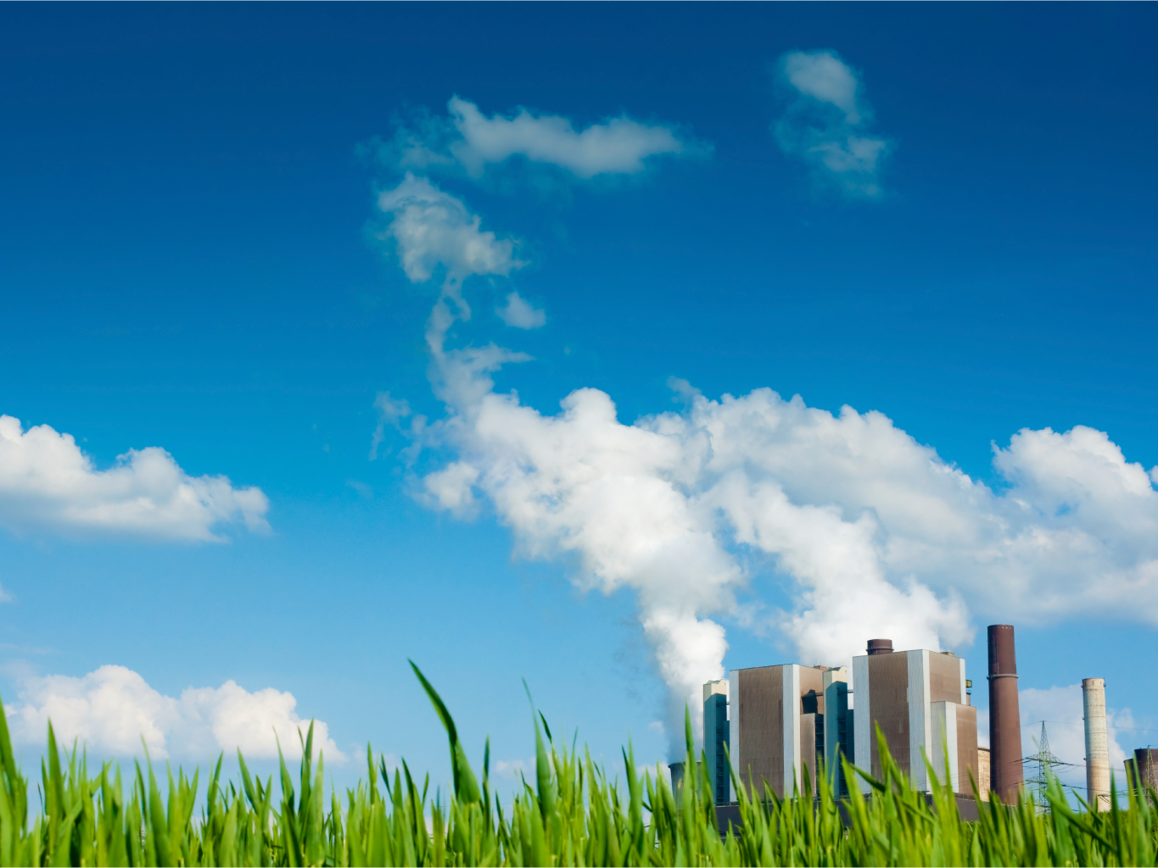
QUESTIONS?
Notes:
We can now open the floor to any questions you may have, points to discuss, or issues you would like to bring up to the group.

