Slide 1


Slide 2
Purpose
The CARBON DIOXIDE SAFETY Program has been published by the RFA to help facilities understand CO₂ health effects and control CO₂ exposures

Slide 3
The RFA’s CO₂ Safety Program:
Provides an overview of the chemical and physical properties of carbon dioxide,
Explains where CO₂ comes from and how it is produced in the ethanol industry;

Slide 4
The RFA’s CO₂ Safety Program:
Discusses the many uses of CO₂;
Presents accidents that have resulted from CO₂ overexposures;
Reviews the U.S. established worker exposure limits;

Slide 5
The RFA’s CO₂ Safety Program:
Covers the health and physical hazards associated with carbon dioxide in all its forms,
Gives detailed procedures and methods for eliminating these exposures – or at least controlling them to an acceptable degree;

Slide 6
The RFA’s CO₂ Safety Program:
Gives specific safety awareness information, and
Explains in detail safe handling procedures and specific methods for hazard minimization

Slide 7
The RFA’s CO₂ Safety Program:
Also provides four written training programs coving the various aspects of the Program.
Training programs are independent of each other and can be given in any order

Slide 8
Module 2:
Exposure Incidents and Health Effects of CO₂
Renewable Fuel Association

Slide 9
Today’s Presentation: Incidents and Health Effects of CO₂
Accidental exposure injuries & fatalities
Adverse health effects
Symptoms of overexposure
Workplace exposure limits
Establishing your facility’s exposure limits

Slide 10
CO₂ Is a Toxic Gas
Until now little information has been available on the adverse health effects of carbon dioxide
CO₂ is not an asphyxiant gas
It can cause death even if there is plenty of oxygen present
Notes:
These data are from the National Institute of Occupational Safety and Health (NIOSH) and other studies. And since CO₂ is odorless, tasteless, and colorless, there is no indication that it is even there.

Slide 11
CO₂ Toxic Health Effects
Breathing concentrations of 30% CO₂, even with 70% oxygen, leads to unconsciousness in 30 seconds
Notes:
These data are from the National Institute of Occupational Safety and Health (NIOSH) and other studies. And since CO₂ is odorless, tasteless, and colorless, there is no indication that it is even there.

Slide 12
Develop a Site CO₂ Management Program
Identify operational areas where
CO₂ can collect, and then follow
procedures and methods to ensure
that CO₂ is dispersed to safe levels.
Notes:
These data are from the National Institute of Occupational Safety and Health (NIOSH) and other studies. And since CO₂ is odorless, tasteless, and colorless, there is no indication that it is even there.

Slide 13
CO₂ Electronic Monitors
Review your exposures
Learn how and when to use all types of electronic monitors

Slide 14
CO₂ Electronic Monitors (cont.)
Use hand held multi-gas (5-gas) monitors with a CO₂ sensor for surveys and confined spaces
Use personal clip-on monitors for personal plant work
Use mounted ones for areas where CO₂ levels can be monitored remotely and measured continuously – and in some cases, interlocked to start ventilation equipment.

Slide 15
Implement a Site CO₂ Safety Program
“Your facility may have been doing what it has been doing for years, not knowing that circumstances can change just a little bit and lead to a terrible injury or fatality “
Eric Fasnacht, Plant Manager, Archer Daniels Midland Co., Cedar Rapids, IA.

Slide 16
What kinds of situations result in exposures to CO₂ that are making people sick or killing them?

Slide 17
Example Accident #1
A beer manufacturer in Houston received multiple citations from OSHA for failing to protect workers from exposure to CO₂ and other workplace hazards while working in brewery cellars.

Slide 18
Example Accident #1 (cont.)
This company was issued a proposed penalty of $88,000 and was required to implement many engineering, equipment, training, and program changes to reduce the probability of a recurrence, along with paying the hefty fine.

Slide 19
Example Accident #2
Just a few months later, two men were found unconscious as they did maintenance in an ethanol production facility. One died and one still has residual neurological damage from the CO₂ overexposures.

Slide 20
To take action to protect workers first we must first:
Understand how dangerous CO₂ is to breathe, and
recognize how and where carbon dioxide gas can accumulate
Notes:
What is the common thread in these two accidents? It is the failure to recognize how and where carbon dioxide gas can accumulate, to understand how dangerous it is to breathe, and to take action to protect workers.

Slide 21
Adverse CO₂ Heath Effects
Even up to fairly recent times, it had been commonly thought that carbon dioxide is a relatively non-toxic gas and it had been classed as a simple asphyxiant.
This is because carbon dioxide is part of every breath we exhale, so people feel it is a safe gas.
Notes:
However, at the concentrations of carbon dioxide in our exhaled air, it is lethal in just a few minutes if inhaled. CO₂ is a toxic waste product that our body must eliminate. As we breathe out, it is diluted in the atmosphere negating its toxic effects.
Little safety information has been available to assist manufacturers in recognizing, controlling and preventing unsafe levels of carbon dioxide. Because of the lack of understanding of its hazardous effects, CO₂ is an unsuspected dangerous gas at elevated levels.

Slide 22
Adverse CO₂ Heath Effects
The concentration of CO₂ in fresh air is 400 ppm (0.04%).
In 2012 it was conclusively demonstrated that in less than 2½ hours, exposure to 1,000 ppm can impair thinking, concentration, and logical thought processes.
Notes:
However, at the concentrations of carbon dioxide in our exhaled air, it is lethal in just a few minutes if inhaled. CO₂ is a toxic waste product that our body must eliminate. As we breathe out, it is diluted in the atmosphere negating its toxic effects.
Little safety information has been available to assist manufacturers in recognizing, controlling and preventing unsafe levels of carbon dioxide. Because of the lack of understanding of its hazardous effects, CO₂ is an unsuspected dangerous gas at elevated levels.

Slide 23
Historic CO₂ Exposures
CO₂ gas was known in mines as
“black damp.”
Notes:
For centuries, since before scientists recognized that there was a gas that we now know as carbon dioxide, overexposure to CO₂ was known to be hazardous, and potentially fatal. In coal and other mining operations, miners called this gas, “black damp,” and used mice and canaries to give a warning when too much was present (they became unconscious or died).

Slide 24


CO₂ Extinguishes a Candle
Notes:
Candles were also used – and when the flame flickered and went out, miners knew the air was not safe and they had to leave. Even so, many people died as a result of overexposures to carbon dioxide. Too often, a little bird keeling over or a candle going out was not enough of a warning to escape.

Slide 25
Present Day CO₂ Exposures
People are still experiencing adverse health effects from overexposures to carbon dioxide on the job.
Fatalities are still way too common.
Notes:
Carbon dioxide now has so many uses and is present in so many processes, protecting people from overexposures can be difficult, especially since high concentrations of CO₂ give no warning to the person breathing it.

Slide 26
Present Day CO₂ Exposures
Part of this problem is the pervasive belief that since we exhale carbon dioxide – and therefore are exposed to it with every breath – it is not toxic.
This belief has been hard to dispel.

Slide 27
Present Day CO₂ Exposures
Even some safety professionals, industrial hygienists, and doctors persist in believing that carbon dioxide is little more than a simple asphyxiant.
Many also believe that when someone develops nausea, severe headaches, seizures, and unconsciousness, once they are re-exposed to fresh air, they will recover fully.
They are wrong on both counts.
Notes:
Before we discuss all the adverse health effects caused by exposures to CO₂, lets take a look at accidents and fatalities that have resulted from excessive CO₂ exposures.

Slide 28
Examples of Accidental Overexposures to Carbon Dioxide
Notes:
Carbon Dioxide has many varied uses in industry. But no matter the application, excess CO₂ has the same toxic effects on the workers.

Slide 29
Dry ice manufacturing and transporting
Dry ice off-gases, and if there is limited ventilation, people may be overexposed and die.
Notes:
People that manufacture dry ice and transport it are sometimes in situations where the dry ice off-gases and there is not enough air movement to keep the concentration at safe levels. Closed vehicles, unventilated rooms, tight work spaces that have little fresh air exchange, and enclosed areas are all places where people inadvertently find themselves in high concentrations without realizing it because there is no warning.

Slide 30
People Have Died From Breathing CO₂:
Being used on stage as a “special effects” fog.
When faulty manifold systems or piping from beverage dispensing machines leak, (CO₂ is used to make the “fizz” in soft drinks) and the concentration builds up.

Slide 31
People Have Died From Breathing CO₂: (cont.)
In food processing facilities and freezers;
In plants where CO₂ cylinders, tank trucks and rail cars are filled and handled; and
When piping systems in refrigeration units have leaked. This has resulted in the deaths of many people.

Slide 32
People Have Died From Breathing CO₂: (cont.)
A couple has even been overexposed in their basement from an abandoned coal mine under their house; and
Hundreds of people living in a low-lying area surrounding a lake were killed when an underground eruption released CO₂ that bubbled out of the lake and spread out in the surrounding area.
Notes:
This happened more than once in Africa, and hundreds of people at a time died in their sleep.

Slide 33
Beer and Ethanol Production Industries
In beer manufacturing and ethanol production, because CO₂ is a natural by-product of the processes, people can routinely be over-exposed to carbon dioxide.
Notes:
Without constant vigilance by everyone, overexposures can occur that can be serious or even fatal.

Slide 34
Specific Cases of Accidental Injuries and Fatalities Involving Exposures to CO₂ in Ethanol and Beer Production

Slide 35
Beer Production
OSHA citations for failure to protect workers
Assessed penalties of $88,000
Implementation of many changes
Notes:
In October 2012, a beer manufacturer in Houston received multiple citations from OSHA for failing to protect workers from exposure to CO₂ and other workplace hazards while working in brewery cellars. This company was issued a proposed penalty of $88,000 and was required to implement many engineering, equipment, training and program changes to reduce the probability of a recurrence, along with paying the hefty fine.

Slide 36
Ethanol Production
CO₂ overexposure caused one fatality and one permanently disabling injury
Notes:
In January 2013, two men were found unconscious as they did maintenance in an ethanol production facility. One died and one has residual neurological damage from the CO₂ overexposures. We are going to explore this accident in detail. Chapters of the Carbon Dioxide Safety Manual are presented in other modules. These present changes that the ethanol industry is making to protect its workers from a similar accident.

Slide 37
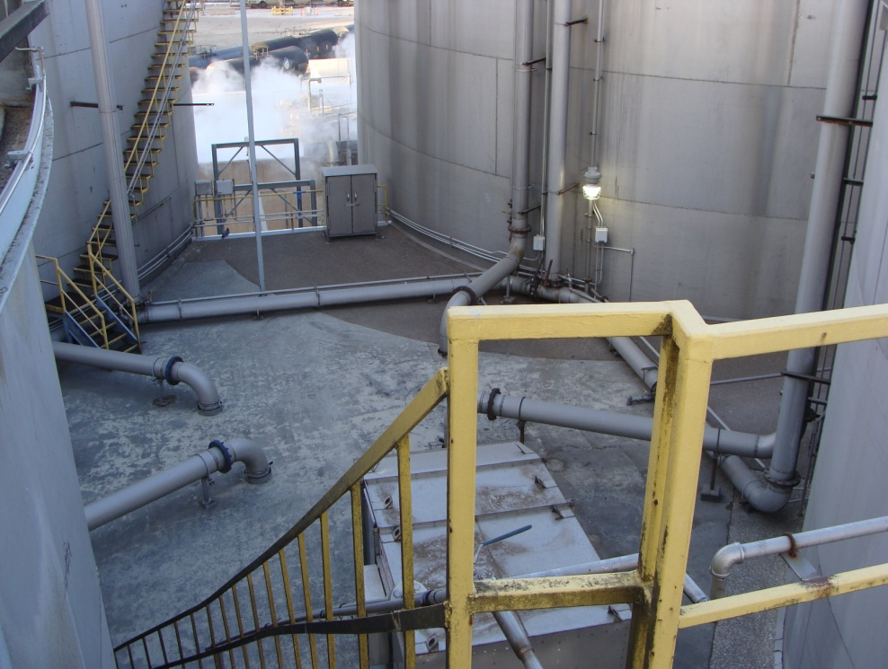
The Top of the Interstice Building
Notes:
Four large fermenters stood adjacent to each other in a “4-pack” arrangement. A small 2-story interstice building was located in between the 4 vessels, with ¼ of the curve of each vessel inside the building. The interstice building housed pumps, piping, and heat exchangers that needed to be protected from freezing during cold weather.
The base of the fermenters together with the bottom part of the interstice building were located within a containment dike, and there were multiple points at which to go over the dike and down to the base of the fermenters on the first floor of the building.

Slide 38
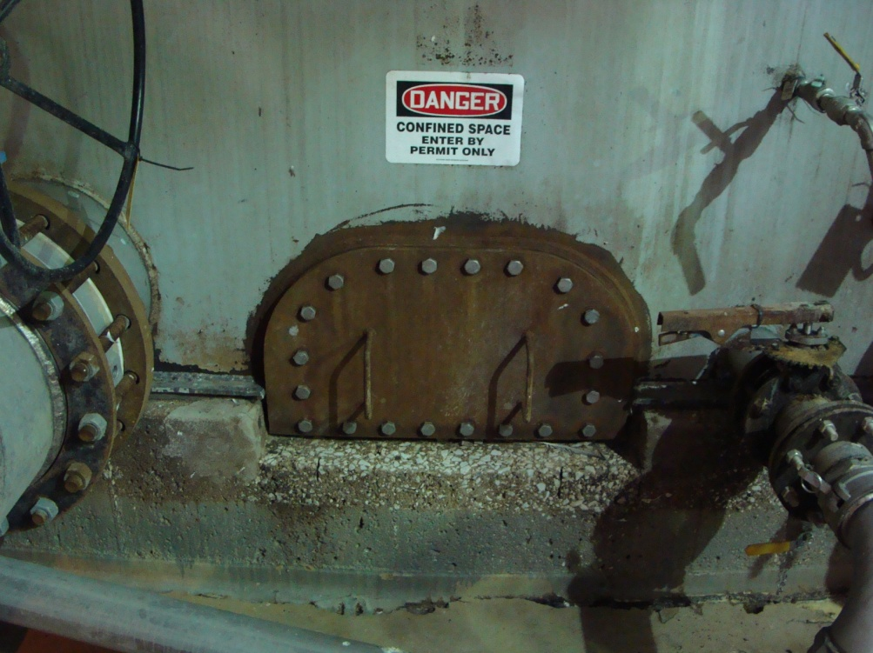
D-shaped Manway (Inside the Building)
Notes:
Each fermenter had a small D-shaped manway inside the building. The flange for the flat part of the D extended slightly below the bottom of each fermenter, so that by removing the D manway, residual mash could drain out of the fermenter onto the floor, where it flowed to a sump pump to allow it to be reclaimed. This allowed for the complete draining of each fermenter.

Slide 39
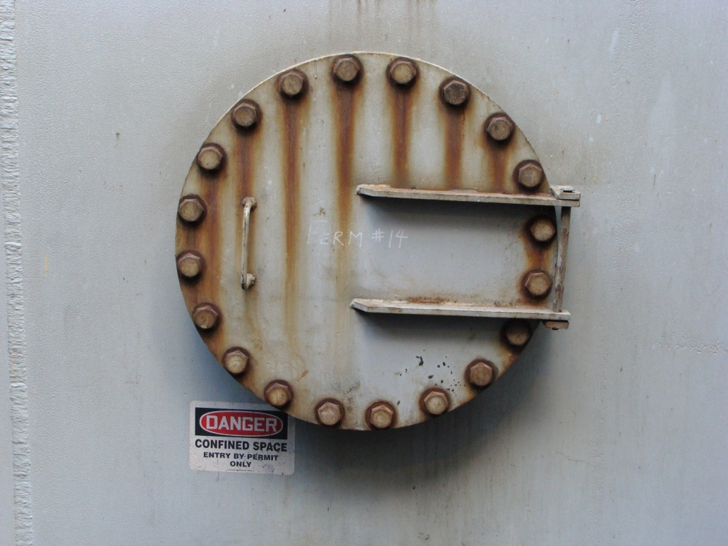
Round Manway (Outside of the Building)
Notes:
Each fermenter also had a larger round manway outside of the building, and each of these manways was the entry point for its respective fermenter if there was a need to make an entry.
Preparations were being made to drain and sterilize one of the fermenters. The fermenter had been emptied as far as the normal discharge piping and associated pump would allow, and the next step was to open up the D manway to allow the residual mash in the bottom to drain out, and also open the outside manway to begin to ventilate the vessel. Historically the maintenance workers would either open the D manway inside the building, then go outside, open the outside manway, then exit out of the diked area; or they would open the outside manway, go into the building and open the D manway, then walk out of the building and go up over the dike.
On the morning of the incident, the maintenance workers opened the D manway inside the building, then went outside and opened the outside manway, then went back into the building.
Tragically, during the time that they were opening the outside manway, enough carbon dioxide had migrated out of the fermenter through the D manway that an Immediate Danger to Life and Health (IDLH) atmosphere now existed inside the interstice building. Both workers passed out, one on the floor and the other in a seated position leaning back against a set of steps. While exact times cannot be pinpointed, it is believed that they may have been exposed to high carbon dioxide levels for as long as 45 minutes. They were discovered by two other employees who entered the building to start another job, and who then immediately initiated emergency procedures. By that time, there was no longer an IDLH atmosphere in the building.
The worker found on the floor did not survive. The other worker survived but continues to suffer from neurological damage done by the extended exposure to high levels of carbon dioxide.
After a thorough investigation and input from many experts, the lessons learned resulted in both engineering and procedural changes that now allow for the carbon dioxide to be evacuated from the fermenters before either manway is removed.

Slide 40
CO2 is NOT an Asphyxiant Gas, it is Toxic
Notes:
In this section we are going to review some of the ways that people become sick, ill, or die from their exposures to CO₂. We will also look at some of the subtle adverse mental effects that low-level overexposures to carbon dioxide can cause. This is important, because people that work with and around CO₂ need to be able to recognize these symptoms in themselves and others before they the symptoms become serious.

Slide 41
What went wrong?
During the time that they were opening the outside manway, enough CO₂ had migrated out of the fermenter through the D manway that an Immediate Danger to Life and Health (IDLH) atmosphere now existed inside the interstice building.
IDLH = 40,000 ppm or 4% CO₂
Notes:
In this section we are going to review some of the ways that people become sick, ill, or die from their exposures to CO₂. We will also look at some of the subtle adverse mental effects that low-level overexposures to carbon dioxide can cause. This is important, because people that work with and around CO₂ need to be able to recognize these symptoms in themselves and others before they the symptoms become serious.

Slide 42
What happened to the workers?
Both workers passed out, one on the floor and the other seated, leaning back against some steps.
The worker found on the floor did not survive.
The other has permanent neurological
damage done by the extended high levels of CO₂
exposure.
Notes:
Research has shown that carbon dioxide is far more hazardous than previously thought. In 2012, it was conclusively demonstrated that even concentrations as low as 1,000 ppm impair thinking, concentration, and logical thought processes. This is quite serious, especially when considering how critical it is for employees to be able to make quick process decisions unimpaired.

Slide 43
CO2 is NOT an asphyxiant gas.
It is toxic.

Slide 44
Symptoms of CO₂ Overexposure
Exposure to only 1000 ppm for 2½ hours impairs thinking, concentration, and logical thought processes.
Notes:
Research has shown that carbon dioxide is far more hazardous than previously thought. In 2012, it was conclusively demonstrated that even concentrations as low as 1,000 ppm impair thinking, concentration, and logical thought processes. This is quite serious, especially when considering how critical it is for employees to be able to make quick process decisions unimpaired.

Slide 45
Symptoms of CO₂ Overexposure (cont.)
Even in the presence of normal concentrations of oxygen (20.9%), death will occur at 7% CO₂ after only 5 minutes.
30% carbon dioxide, even with 70% oxygen, leads to unconsciousness in 30 seconds. Death rapidly follows.
Notes:
Research has shown that carbon dioxide is far more hazardous than previously thought. In 2012, it was conclusively demonstrated that even concentrations as low as 1,000 ppm impair thinking, concentration, and logical thought processes. This is quite serious, especially when considering how critical it is for employees to be able to make quick process decisions unimpaired.

Slide 46
Symptoms of CO₂ overexposure (cont.)
6% CO₂ can produce hearing and visual disturbances within 1 to 2 minutes
10% to 15% CO₂ leads to dizziness, drowsiness, severe muscle twitching, and unconsciousness, and
Notes:
Elevated exposures can be deadly. According to the EPA, “Exposure to a concentration of 6% CO₂ can produce hearing and visual disturbances within 1 to 2 minutes. Exposure to concentrations from 10% to 15% CO₂ leads to dizziness, drowsiness, severe muscle twitching, and unconsciousness within a few minutes. Exposure of humans to CO₂ concentrations ranging from 17% to 30% quickly (within one minute) leads to the loss of controlled and purposeful activity, unconsciousness, coma, convulsions, and death
Let’s look are exposures that are closer to what we can fairly easily find in an ethanol production plant, a beer manufacturing facility, and at a grain handling operation.
Here is a “CO₂ ADVERSE HEALTH EFFECTS FACT SHEET” for your use and quick reference. DISTRIBUTE “CO₂ ADVERSE HEALTH EFFECTS FACT SHEET”

Slide 47
Symptoms of CO₂ overexposure (cont.)
17% to 30% quickly (within one minute) leads to the loss of controlled and purposeful activity, unconsciousness, coma, convulsions, and death.
Notes:
Elevated exposures can be deadly. According to the EPA, “Exposure to a concentration of 6% CO₂ can produce hearing and visual disturbances within 1 to 2 minutes. Exposure to concentrations from 10% to 15% CO₂ leads to dizziness, drowsiness, severe muscle twitching, and unconsciousness within a few minutes. Exposure of humans to CO₂ concentrations ranging from 17% to 30% quickly (within one minute) leads to the loss of controlled and purposeful activity, unconsciousness, coma, convulsions, and death
Let’s look are exposures that are closer to what we can fairly easily find in an ethanol production plant, a beer manufacturing facility, and at a grain handling operation.
Here is a “CO₂ ADVERSE HEALTH EFFECTS FACT SHEET” for your use and quick reference. DISTRIBUTE “CO₂ ADVERSE HEALTH EFFECTS FACT SHEET”

Slide 48
Other symptoms of overexposure by inhalation include:
Dizziness, headache, nausea, rapid breathing,
Shortness of breath, deeper breathing, increased heart rate (tachycardia),
Eye and extremity twitching, cardiac arrhythmia,

Slide 49
Other symptoms of overexposure by inhalation include:
Memory disturbances, lack of concentration
Visual and hearing disturbances, including photophobia, blurred vision, transient blindness, hearing loss and ringing in the ears

Slide 50
Other Symptoms of overexposure by inhalation (cont.)
Sweating, restlessness, vomiting, shaking, confusion, flushed skin, panic,
Parathesis (a sensation of numbness in the extremities), disorientation, convulsions,
Unconsciousness, coma, and death.
Notes:
These adverse health effects have been known for more than forty years. (NIOSH, 1976).

Slide 51
CO₂ Inhalation Limits
5,000 ppm (0.5%) is the legal workplace 8-hour exposure limit for CO2.
However, at this concentration, the very healthy and physically fit International Space Station crew experienced headaches, lethargy, mental slowness, emotional irritation, and sleep disruption, even though oxygen concentrations were maintained at 20.9%.
Notes:
The mission was going to have to be aborted because of the carbon dioxide, but a makeshift scrubber system allowed the CO₂ to be removed and the mission to continue. Keep in mind, normal concentration in air is only 400 ppm (0.04%).

Slide 52
CO₂ Inhalation Symptoms
At 2,500 ppm for 2.5 hours, most measured cognitive functions are impaired to the extent that the individuals are rendered cognitively marginal or dysfunctional.
Notes:
A recent study in the United States of humans exposed in only 2.5 hour sessions showed serious decreases in cognitive abilities at only 1,000 ppm (0.1%). At a concentration of only
2,500 ppm for 2.5 hours, most measured cognitive functions were impaired to the extent that the individuals were rendered cognitively marginal or dysfunctional. The functions measured included task orientation, initiative, information usage, and use of basic strategy.

Slide 53
CO₂ Exposures in Ethanol Production
Yeast releases CO₂
CO₂ is a byproduct of metabolic activity of grain and other organisms
CO₂ is a toxic waste product given off by the body as a gas

Slide 54
Deciding Plant-Specific CO₂ Alarm Levels
Determine the lowest acceptable level of CO₂ exposure that your facility can operate under
Trial and error may work to establish this point
May be different in different parts of the facility
Under no circumstances should your level be higher than 5,000 ppm

Slide 55
Prevent Unsafe CO₂ Levels (cont.)
Sensors should be located at dead areas and remote corners of buildings where little ventilation is present; worst case locations
Dead spaces give a better indication of actual CO₂ accumulations that can jeopardize worker safety

Slide 56
These forms of CO₂ are very cold and can cause freezing burns, blisters and frostbite
Liquid and solid (dry ice) CO₂
Notes:
Carbon dioxide can also cause injury in the liquid and solid (dry ice) forms. This is mainly because under pressure it is very cold; as the gas is released from a steel cylinder or is released from a fire extinguisher or a pipe break, CO₂ can cause serious burns, blisters, and frostbite.

Slide 57
United States Exposure Limits
8-hr. Work Day Exposure Limit –
5,000 ppm, TWA₈
15 min. Short-Term Exposure Limit, max of 4 times/day – 30,000 ppm (3%)
IDLH (Immediately Dangerous to Life or Health) – 40,000 ppm (4%)

Slide 58
REMEMBER: These exposure limits were established nearly 50 years ago and do not protect worker safety and health, especially cognitive and other functions.
It is the responsibility of your facility to take this information and use it to protect your work force.

Slide 59
Other Exposure Limits
Many countries have legal exposure limits that are significantly lower than the United States, and others are reviewing carbon dioxide studies and re-evaluating their legal exposure limits.

Slide 60
Immediate First Aid
Gaseous carbon dioxide, immediate first aid includes removing the exposed worker from the exposure area to fresh air and restoring breathing by trained personnel

Slide 61
Immediate First Aid
Liquid or solid carbon dioxide, quickly remove contaminated clothing and rinse contaminated skin gently with lukewarm, not hot, water. Do NOT rub any skin or affected areas. Transfer promptly to a medical facility for evaluation and treatment.

Slide 62
Closing Summary
CO₂ is a toxic gas, can cause serious permanent medical conditions, and can cause death within minutes
Even 1000 ppm can impair cognitive function
Keep plant levels as low as possible and use ventilation to do this, even if the weather may make this uncomfortable at times

Slide 63
QUESTIONS?

Slide 64
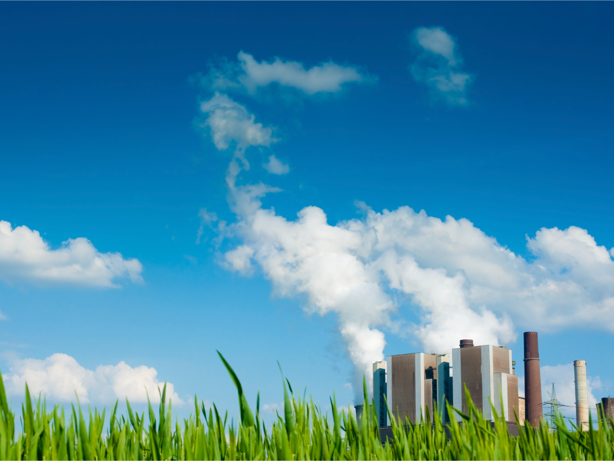

Slide 65
Supplemental Slides: the Adverse Physiological Effects of CO₂ on the Human Body

Slide 66
How Inhaled CO₂ Affects the Body Physiologically
Composition of normal fresh air:
78.00% Nitrogen
20.90% Oxygen
0.80% Argon
0.04% Carbon Dioxide

Slide 67
CO₂ from cell metabolism is exhaled
CO₂ in each breath is ~3.8% (38,000 ppm)
The “average” person produces approximately two pounds of carbon dioxide each day
More CO₂ is given off during strenuous activity.

Slide 68
Hypercapnia, hypercarbia, or hypercapnea
The condition of, and the body’s response to, excessive carbon dioxide
CO₂ in the bloodstream lowers the blood pH.

Slide 69
Acidosis
Acidosis occurs when the pH of the blood becomes less than 7.35.
As CO₂ combines with water in the blood it forms carbonic acid
Returning the blood to normal pH is necessary to protect all body tissues.

Slide 70
How the body compensates for acidic blood (too much CO₂)
Increased breathing rate, increased breathing volume, faster heart rate, and higher blood pressure
Arteries to the brain, spinal cord and heart dilate; other arteries constrict

Slide 71
How is breathing stimulated?
Breathing is stimulated by an excess of CO₂, not an absence of oxygen
The lower pH of the blood, caused by the CO₂ stimulates breathing

Slide 72
High altitudes and acclimatization
The higher the altitude, the fewer molecules of gases in the air. Therefore, the lower the oxygen concentration.
This is often referred to as “thinner air.”
can become unconscious due to lack of oxygen without ever having a sensation of “air hunger.”

