Slide 1


Slide 2
Purpose
This CARBON DIOXIDE SAFETY MANUAL has been published by the RFA to help facilities understand CO₂ health effects and control CO₂ exposures

Slide 3
Overview of the CO₂ Safety
Management Program
Where CO₂ comes from, especially fermentation production of CO₂ during ethanol mfg processes
CO₂ major uses
Chemical and physical properties
Physical hazards and bulk shipments of gaseous, liquid, and solid CO₂

Slide 4
Overview of the CO₂ Safety
Management Program
Accidental exposure injuries and fatalities
Adverse health effects
Symptoms of overexposure
Workplace exposure limits
Immediate first aid

Slide 5
Overview of the CO₂ Safety Management Pgm. (cont.)
Developing a site CO₂ safety management program
Guidelines for maintaining safe working conditions, including safety awareness, safe handling, and hazard minimization

Slide 6
Overview of the CO₂ Safety
Management Pgm (cont.)
Carbon dioxide detection equipment, including direct reading carbon dioxide gas monitors:
  Personal monitors
  Portable multi-gas monitors
  Stationary monitors

Slide 7
TODAY’S DISCUSSION:
Highlights of the critical topics in the RFA
Carbon Dioxide Safety Manual

Slide 8
Highlights of the Critical Topics in this Manual
Specific case of accidental injury and death involving exposures to carbon dioxide in ethanol production

Slide 9
Highlights of the Critical Topics in this Manual (cont.)
Adverse health effects and symptoms of exposure

Slide 10
Highlights of the Critical Topics in this Manual (cont.)
Developing your site Carbon Dioxide Safety Management Program

Slide 11
Highlights of the Critical Topics in this Manual (cont.)
Overview of electronic CO₂ detection equipment

Slide 12
Major Points to Take Away With You
CO₂ is a toxic gas – not a simple asphyxiant
No matter how much oxygen is in the air, if excessive CO₂ is present, you will become unconscious and die

Slide 13
Major Points
Studies show that even in the presence of normal concentrations of oxygen, death will occur in only 5 minutes at exposures of 7% CO₂
– NIOSH

Slide 14
Since CO₂ is odorless, tasteless, and colorless, there is no indications that it is even there
Learn and remember the adverse health effects of CO₂ and the signs and symptoms of even low-level exposure

Slide 15
Use this Carbon Dioxide Safety Manual to help your facility develop a CO₂ Management Program (a site CO₂ Identification and Control Program): the first step in controlling and preventing hazardous levels of carbon dioxide accumulation

Slide 16
Identify operational areas where CO₂ can collect, and then develop procedures and methods to ensure that CO₂ is dispersed to safe levels

Slide 17
Learn how and when to use all three types of electronic monitors – review your exposures and then decide how to best to use this technology
Notes:
At least consider:
Hand held multi-gas (5-gas) portable monitors with a CO₂ sensor for confined spaces,
Personal clip-on monitors for personal plant work, and
Fixed electronic detectors for areas where CO₂ levels can be monitored remotely and measured continuously – and in some cases, interlocked with ventilation equipment

Slide 18
Your facility may have been doing what it has been doing for years, not knowing that circumstances can change just a little bit and lead to a terrible injury or fatality –
Eric Fasnacht, Plant Manager, Archer Daniels Midland Co., Cedar Rapids, IA.
Notes:
Recognize that current practices may not be acceptable.
Use this manual to improve your program

Slide 19
Recognize CO₂ as a
Toxic Gas Hazard
There is a pervasive belief that since we exhale carbon dioxide – and therefore are exposed to it with every breath – it is not toxic. This belief has been hard to dispel.
.

Slide 20
Handle CO₂ as a Toxic Gas Hazard
Even many public health and safety professionals, industrial hygienists, and doctors persist in believing that carbon dioxide is little more than a simple asphyxiant. They are wrong.

Slide 21
Handle CO₂ as a Toxic Gas Hazard (cont.)
Many also believe that when someone experiences nausea, severe headaches, seizures, and unconscious-ness from CO₂, fresh air will revive them, and they will recover fully.
This is wrong.

Slide 22
FATAL ACCIDENT

Slide 23
In January 2013, two men were found unconscious as they did maintenance in an ethanol production facility.
One died and one has permanent, residual neurological damage from the CO₂ overexposures.

Slide 24
Four large fermenters stood adjacent to each other in a “4-pack” arrangement
A small 2-story interstice building was located in between the 4 vessels, with ¼ of the curve of each vessel inside the building

Slide 25
The interstice building housed pumps, piping, and heat exchangers that needed to be protected from freezing during cold weather

Slide 26
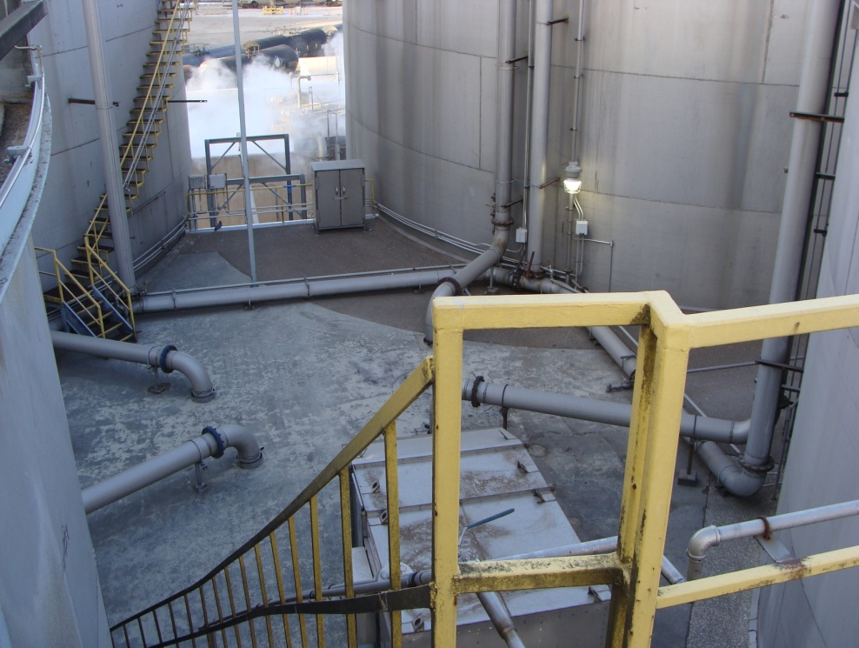
Top of the Interstice Building

Slide 27
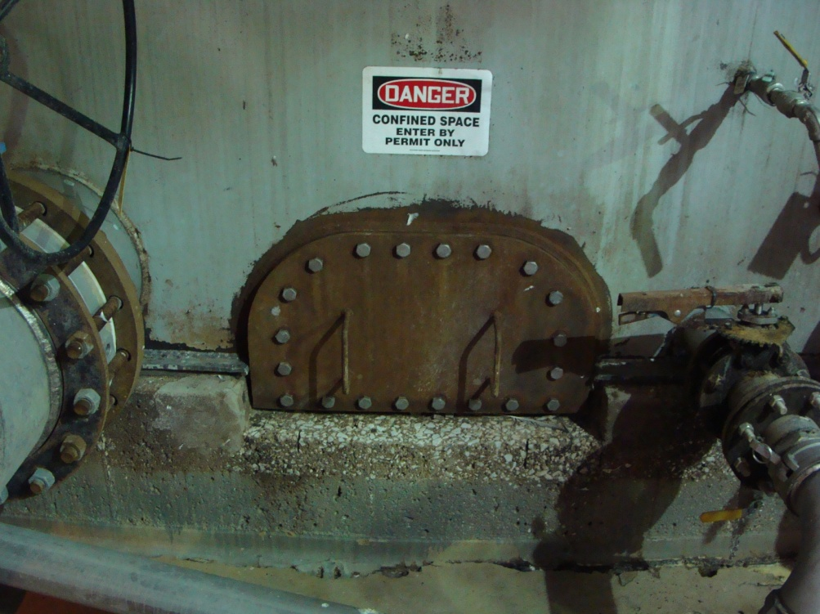
Each fermenter had a small D-shaped manway inside the building

Slide 28
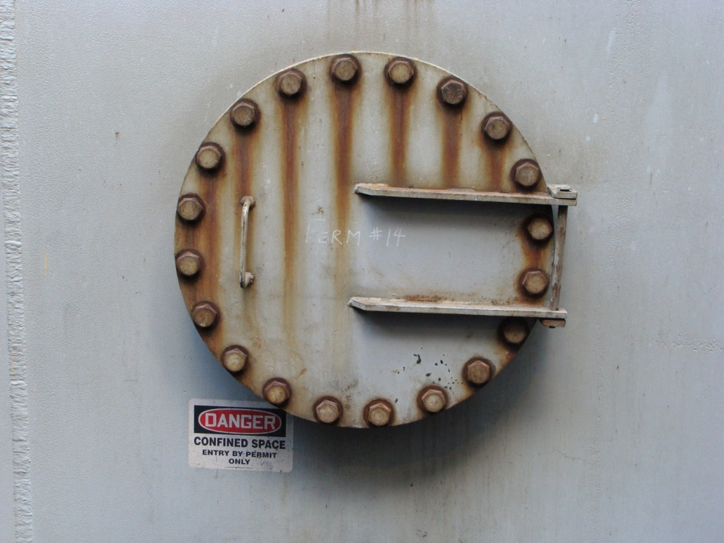
Each fermenter also had a larger round manway outside of the building, and each of these manways was the entry point for its fermenter.

Slide 29
On the morning of the incident, the maintenance workers opened the D manway inside the building, then went outside and opened the outside manway, and then went back into the building.

Slide 30
An IDLH atmosphere was released into the interstice building from the opened fermenter. So when they returned they were overcome by carbon dioxide.

Slide 31
45 minutes or so later they were found, one unconscious, the other dead. The one who was revived has sustained permanent neurological damage.

Slide 32
Prevention
Recognize how and where carbon dioxide gas can accumulate
Understand how dangerous it is to breathe
Take action to protect workers

Slide 33
Developing the CO₂ Management Program (Site CO₂
Identification and
Control Program)

Slide 34
KNOW YOUR PROCESS!
RECOGNIZE THE HAZARDS!

Slide 35
Best Practices: Develop a CO₂ Management Program

Slide 36
Recognize where carbon dioxide can accumulate – especially during different processes, seasons and weather conditions

Slide 37
Large amounts of carbon dioxide can accumulate in many areas. Unsafe levels of carbon dioxide are not only present in confined space areas, but depending upon weather and other conditions, carbon dioxide can be found in nearly all areas.

Slide 38
Consider where you can have a catastrophic level of CO₂ under the right conditions and actively look for these areas.

Slide 39
Examples of Places That Could Accumulate CO₂

Slide 40
Ground floor locations and other low-lying areas, including those outdoors and around the water treatment containment areas (including anaerobic and aerobic tanks)

Slide 41
In grain receiving areas due to new crop respiration and limited ventilation, including under the corn receiving tunnels.

Slide 42
Locations where carbon dioxide is given off from processes
Notes:
including inside the buildings that house the fermentation tanks, the fermentation tanks themselves, yeast propagation, grain receiving and unloading areas, hoppers, slurry/mash “steep” tanks, and drains that collect liquid materials and pump it out.

Slide 43
Areas where carbon dioxide is collected and discharged, especially the carbon dioxide scrubber, and the baghouse

Slide 44
Locations with restricted or limited ventilation whatever the elevation, especially those areas where people rarely need to go

Slide 45
Confined areas and confined spaces, including diked areas around any kind of tank

Slide 46
Although carbon dioxide is heavier than air, warm or heated CO₂ rises and floats away. It can then travel to remote locations as it cools and then collect in unsuspected areas, depending upon air temperature, wind direction and speed.

Slide 47
Develop a Carbon Dioxide Facility Review Process
Notes:
Be sure to survey the facility under both normal and abnormal process conditions to establish normal vs. abnormal CO2 levels.
» Conduct multiple surveys throughout the year and repeat walk-throughs during various weather conditions in order to understand any effects that changes in ambient
temperatures may have on CO2 levels. This will give the most comprehensive results. The differences can be surprising.

Slide 48
Conduct a comprehensive walk-through survey of the entire facility looking for areas where carbon dioxide can collect, including:
areas of limited air exchange;
low-lying areas;
places where stover, organic waste, and wastewater are stored and can collect; and
process areas known to have elevated CO₂ levels.
Survey must include indoor as well as outdoor areas
Notes:
These surveys should be conducted with a hand-held CO2monitor to allow for greater flexibility identifying CO2levels across the facility.
Be sure to survey on a day when the air is still (very little wind, <5mph) in order to detect pockets where CO2can collect. Wind plays an important part in dissipating CO2

Slide 49
Do not allow CO₂ PRD’s/PRV’s to discharge into work areas, especially indoors
Notes:
PRD’s/PRV’s can sometimes stick open or be open for other reasons, then the areas around this device can accumulate IDLH CO₂ concentrations in a short amount of time. Carefully consider dispersion of CO₂ from these sources.
Carbon dioxide pressure relief devices (PDR’s), or pressure release valves (PRV’s) often allow CO₂ to be vented directly out of its respective process vessel
These PRD’s/PRV’s should be directed to a safe release point such as a scrubber, collection system, or elevated exhaust stack so that CO₂ dispersion does not present a safety hazard
The CO2 released is one of the significant sources of fugitive CO2 emission within any production facility.

Slide 50
Off-gassing from fermenters can cause localized areas of high CO₂ concentrations that can be unsuspected.
Notes:
Open manways and venting PRD’s/PRV’s can result in transient but catastrophically high CO₂ levels.
Take CAUTION to identify all areas where equipment or specific jobs can result in these high CO₂ concentrations.

Slide 51
If possible, vent these release lines to the scrubber if permitting allows. If not, make sure that adequate warnings are posted and that workers wear personal CO₂ monitors.
Notes:
Consider setting up remote sensors with automatically activated forced draft ventilation to reduce these potentially hazardous areas to a minimum.
Whenever possible, install piping, plumbing connections, and vents that contain CO2 above grade and in very well-ventilated areas. Further, consider plumbing connections directly into
the carbon dioxide scrubber or collection system

Slide 52
Include risks of unsafe levels of carbon dioxide as possible
hazards in Job Hazard Analysis (JHA) programs

Slide 53
Identify carbon dioxide monitoring equipment that complements your plant site’s safety program.
Notes:
There is a wide variety of monitoring equipment available today at reasonable costs.
Select multiple gas monitors for your safety program, and for confined space entry, ensure carbon dioxide is one of tested gases.
We will talk about monitors in a few minutes.

Slide 54
Initiate a routine procedure for instituting process and systems modifications and changes, including any time a piece of equipment is changed, and consider carbon dioxide exposure.
Notes:
For the risk evaluation, conduct the review during the design consideration stage, and consider materials of construction, ease of maintenance, and hazards presented by new systems in carbon dioxide service.

Slide 55
Institute a documented routine inspection and testing program for all equipment.
Notes:
This includes process vessels, piping, valves, pressure relief design, hoses, ventilation systems, and detection instruments.

Slide 56
Prevent Unsafe
CO₂ Levels

Slide 57
Having many remote sensors is not enough. Give careful consideration to the placement of these sensors.
Notes:
It is all too common for remote monitors to be placed in the middle of buildings, to get broad representative readings of the general work area. However, this sometimes backfires and results in sensors located along walkways and open areas that have good ventilation. This gives everyone a false sense of security.

Slide 58
In 2012, it was conclusively demonstrated that even concentrations as low as 1,000 ppm impair thinking, concentration and logical thought processes.
Notes:
This is quite serious, especially when considering how critical it is for employees to be able to make quick process decisions unimpaired.

Slide 59
Determine the lowest acceptable level of CO₂ that your facility can operate under to effectively protect workers’ thinking and cognitive abilities – this may be different in different parts of the facility.

Slide 60
Keep in mind that the eight hour time weighted average workplace exposure level established by OSHA in 1970 was 5,000 ppm, so under no circumstances should this level be higher than this.

Slide 61
Ensure mechanical ventilation of work areas, especially those areas in corners or the sides of buildings and vessels where carbon dioxide can collect.
Notes:
The ventilation does not need to run continuously; however, it needs to be able to be activated remotely, before workers enter those areas, or be automatically activated when a carbon dioxide remote monitor reads levels that exceed your facility’s critical set point.

Slide 62
Install remote, continuously monitoring sensors; and implement a preventive maintenance program to maintain proper operation of these CO₂ sensors. This stationary monitoring equipment needs to have local audible and visual alarms.
Notes:
Consider tying the signals into control rooms to notify operators and installing interlocks from the electronic monitors so that ventilation equipment will automatically start up when critical set points are exceeded, which should not be more than 5,000 ppm CO₂

Slide 63
Evaluate and Upgrade
Confined Space Entry Procedures

Slide 64
Now, decades after 49 CFR 1910.146 took effect, although not the biggest single killer, confined space entry is still the #1 cause of multiple fatalities in the workplace.
Notes:
Before the federal OSHA General Industry Confined Space Entry Standard, 49 CFR 1910.146 was promulgated in January, 1986, more people died doing confined space entry work than anything else, except for over-the-road vehicle accidents.

Slide 65
ADVERSE HEALTH EFFECTS AND SYMPTOMS OF EXPOSURE

Slide 66
Symptoms of Overexposure by Inhalation Include:
Dizziness, headache, nausea, vomiting
Rapid breathing, shortness of breath, deeper breathing
Increased heart rate (tachycardia)
Eye and extremity twitching
Cardiac arrhythmia

Slide 67
Memory disturbances, disorientation,
lack of concentration
Visual disturbances, including photophobia, blurred vision, transient blindness
Hearing disturbances, including loss of hearing and ringing in the ears

Slide 68
Sweating, flushed skin
Restlessness, paresthesia (numbness in the extremities)
Shaking
Confusion, panic, convulsions
Unconsciousness, coma, and death

Slide 69
Breathing concentrations of 30% CO₂, even with 70% oxygen, leads to unconsciousness in 30 seconds

Slide 70
In the presence of normal concentrations of oxygen, death will occur at exposures of 7% CO₂ in only 5 minutes
Notes:
Carbon Dioxide overexposure by inhalation is much more serious than previously thought.

Slide 71
In 2012, it was conclusively demonstrated that even concentrations as low as 1,000 ppm impair thinking, concentration and logical thought processes.
Notes:
This is quite serious, especially when considering how critical it is for employees to be able to make quick process decisions unimpaired.

Slide 72
At a concentration of only 2,500 ppm for 2.5 hours, most measured cognitive functions were impaired to the extent that the individuals were rendered cognitively dysfunctional.

Slide 73
Over 45 years ago the 8-hour Time-Weighted Average Workplace Exposure Limit was set at = 5000 ppm (0.5%)
IDLH = 30,000 (3%). It has not been changed yet.
Notes:
But as you can see from the previous slides, 5000 ppm (0.5%) may keep someone from passing out, but don’t depend upon their judgement, reasoning skills or concentration ability! It will be gone within 15 minutes.

Slide 74
At 5,000 ppm (0.5%), the International Space Station crew experienced headaches, lethargy, mental slowness, emotional irritation, and sleep disruption, even though oxygen concentrations were maintained at 20.9%

Slide 75
Fortunately, during the past decade, great strides have been made in developing accurate, rugged, easy to calibrate, and dependable carbon dioxide sensors at a reasonable cost.
Notes:
These sensors can now be part of a multi-gas monitor, such as those used for confined space entry, or be a single gas monitor that is hand-held or worn by the worker

Slide 76
ELECTRONIC CO₂ SENSORS
Below are examples only – not to be construed as an endorsement by the RFA
Notes:
The industry is poised to embrace this technology and train workers to use them as a routine part of production work

Slide 77
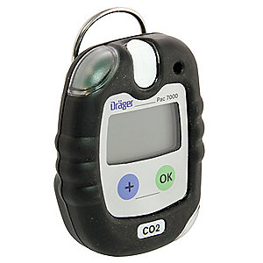
Single Electronic CO₂ Gas Detector
Dräger Model # 8318975
Notes:
An example of a single gas detector with an audible and visual alarm. Workers can wear these when out in the plant. Alarm set points can be changed.

Slide 78
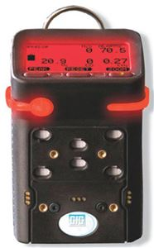
Direct-Reading, Portable, Multi-Gas Electronic Monitor with CO₂ Gas Detector
GfG G460 Multi-Gas Detector
Notes:
Use these for plant surveys and for confined space entry. I suggest you use O2, LEL, H2S, CO and CO2 for sensors.

Slide 79
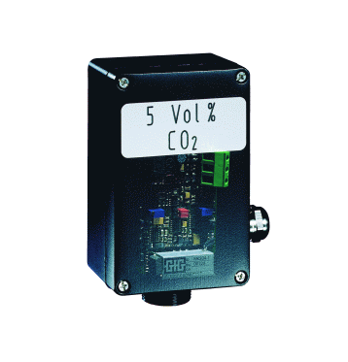
Direct Reading Stationary Instruments
GfG IR 24 Fixed Gas Transmitter
Notes:
These can be tied in to a ventilation system, and can be monitored in your control room.

Slide 80
Summary – Take-Aways
Carbon dioxide is a toxic gas that can kill even when there are normal concentrations of oxygen present
Develop Your Site Carbon Dioxide Safety Management Program

Slide 81
Summary – Take-Aways
Improve procedures and JHA’s
Do site evaluations
Be vigilant for potential carbon dioxide accumulation areas

Slide 82
Summary – Take-Aways
Use electronic monitors for detection, since CO₂ has no warning properties
Set high end exposures levels to protect neurological processes, including judgment and thinking of site personnel

Slide 83
Where to go for More Help
More information and suggestions on:
Steps to developing a CO₂ Management Program,
Adverse health effects of CO₂, and
Electronic instruments & ventilation
Are given in specific training programs

Slide 84
This CARBON DIOXIDE SAFETY MANUAL has been published to help facilities understand CO₂ health effects and control CO₂ exposures.
Use it to make your workplace safer!

Slide 85
